Slide 1

E-Scooter Share Pilot in Chicago
Ziyi Yang

Slide 2
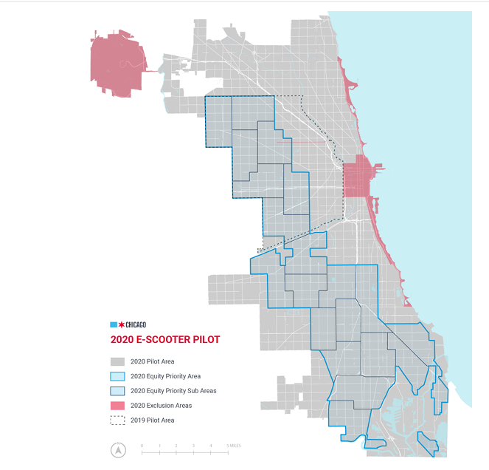
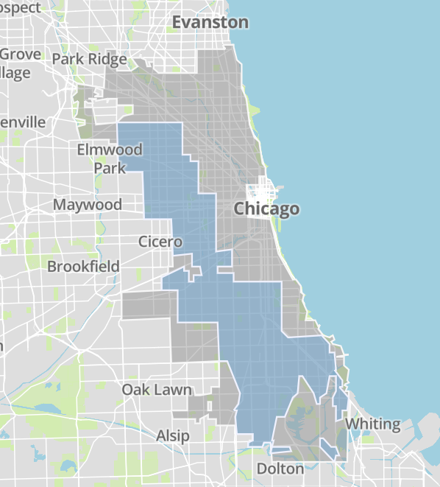
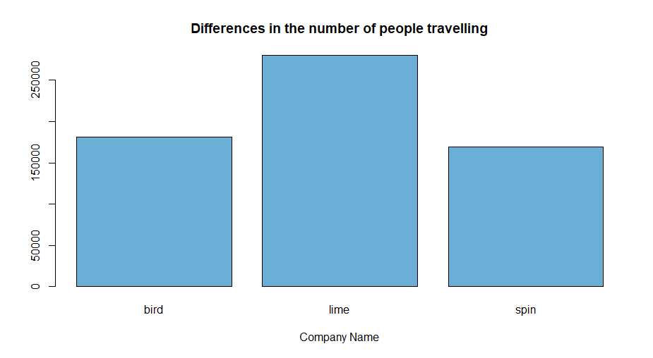
Time: August 12, 2020 to December 12, 2020
Vendors: Bird, Lime and Spin
Each company can offer 3,333 rentable scooters each day between 5 a.m. and 10 p.m.
Price: 1$ to unlock + Bird (32 cents/min)
Spin (39 cents/min)
Lime (19 cents/min in priority areas and 39 cents/min elsewhere)
Notes:
In 2019 and 2020, the city of Chicago conducted a four-month scooter sharing pilot to evaluate the feasibility of Chicago scooter sharing, test technology and rules, and better understand how to form a more durable program.

Slide 3

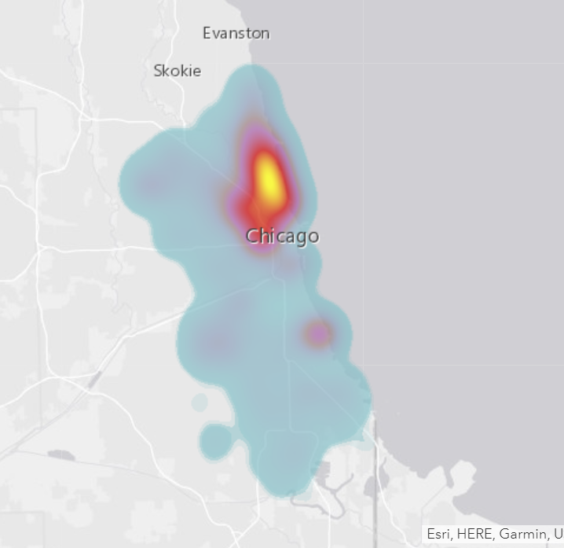
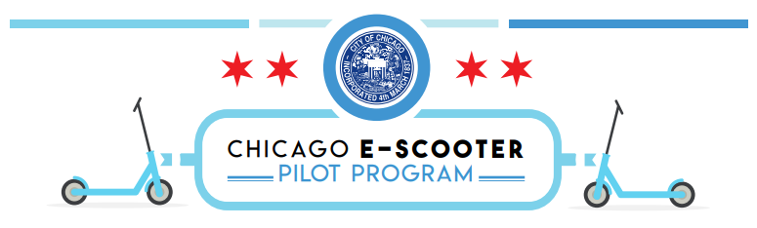
Questions: Who currently has access to scooters?
E-Scooter Trips 2020 (more than 630,000 trips)
Natural and Built Environment (Schools, Transit Stations, etc)
Chicago Demographic Data-- US Census
Notes:
是否有对于scooter需求的不平衡，以及是否会给居民带来不公平的车辆使用权，将通过以下几点
Designed to help city officials predict the geographic distribution of scooter riders in their cities and understand its relationship to the social and economic geography of the city.

Slide 4
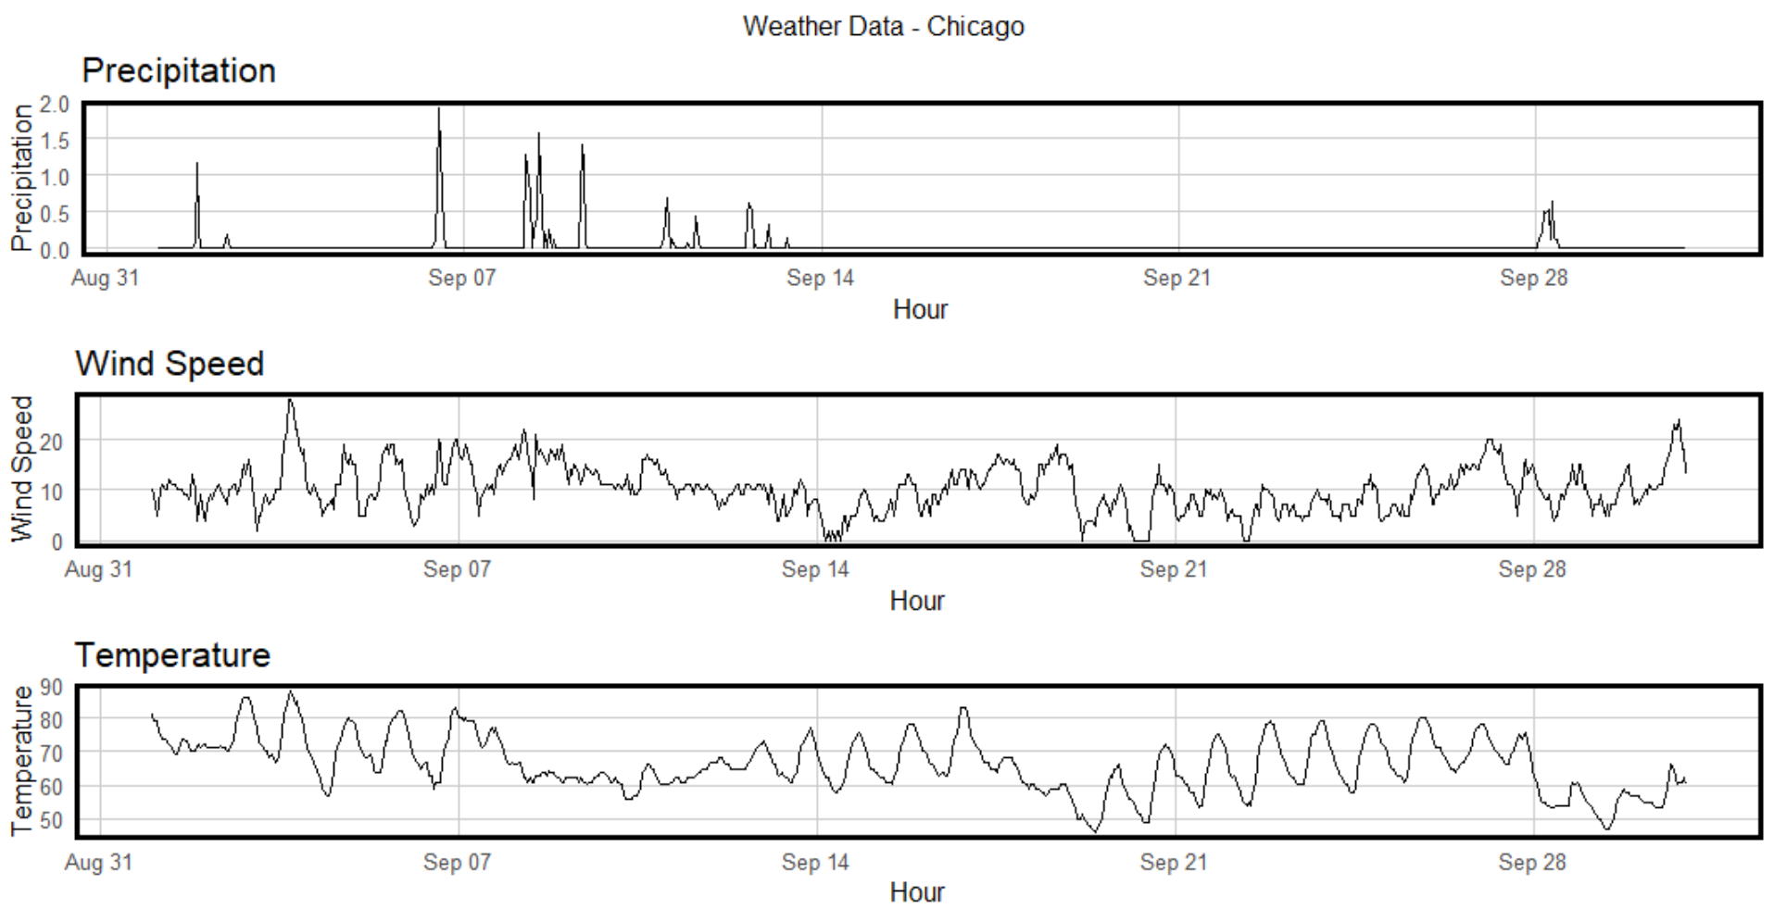
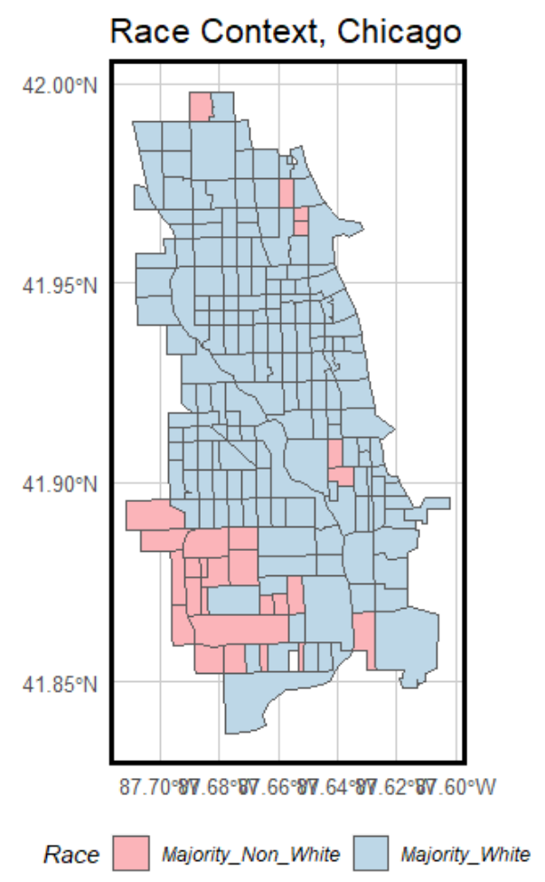
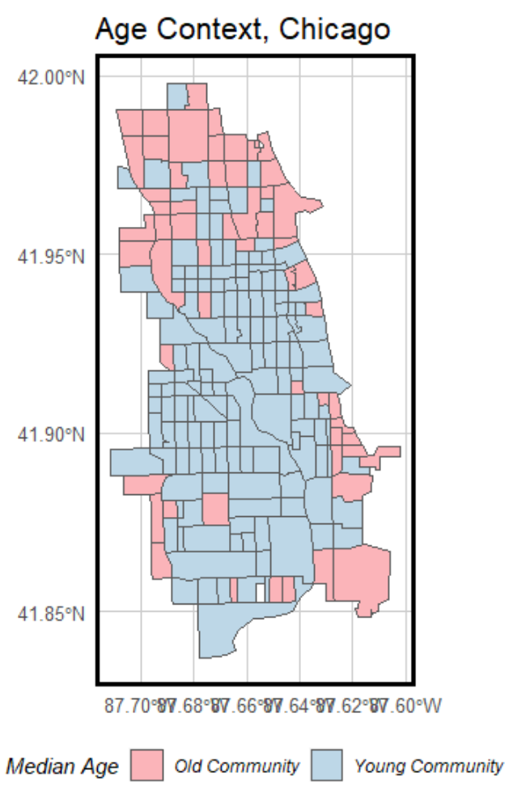
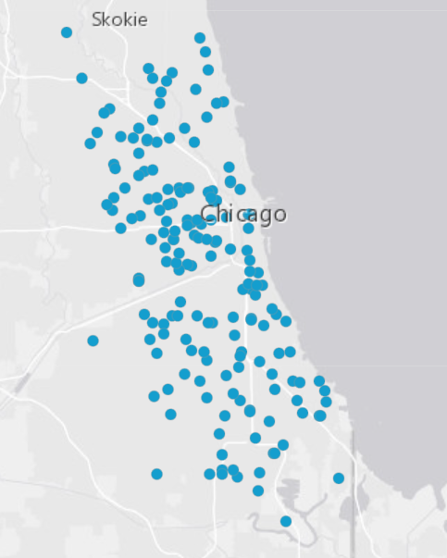
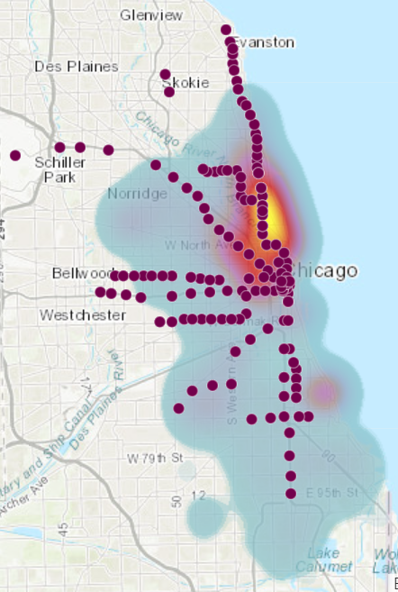
Factors affecting travel
- Natural (precipitation, temperature, wind)
- Built Environment (transit, shopping, restaurant, school)
- Socio-economic (house income, race, age)
High Schools
L Stations

Slide 5
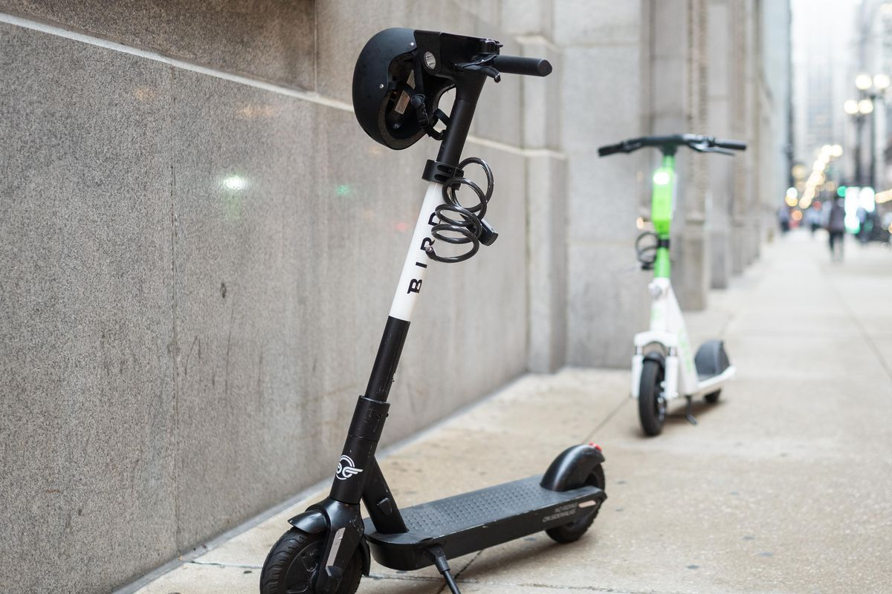
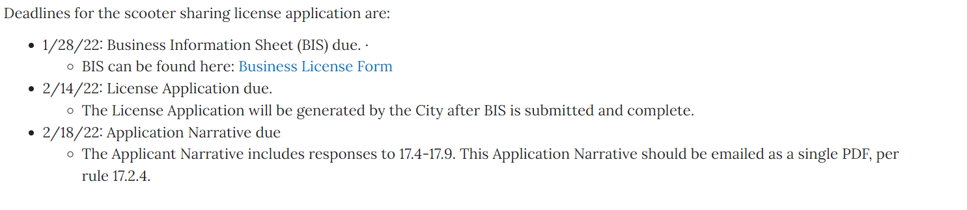
Future Works:
Built environment
Model & Prediction
Vendors--- Priority area?
Permanent Scooter Program in 2022 ?
https://www.chicago.gov/city/en/depts/cdot/supp_info/escooter-share-pilot-project.html
Notes:
The final results will enable policy makers to predict the geographical distribution of scooter riders in their cities and understand the inequities that may be created by the final planning-starting and managing scooter sharing systems in a routine manner.

